Slide 1
1 Planed
Planed 1
Finish the study of PE format this week and complete the test of PE parse on my own.
4

Slide 2
1 Results
Results 1
The last part , import directory have not learned. I plan finish it in two days.
4

Slide 3
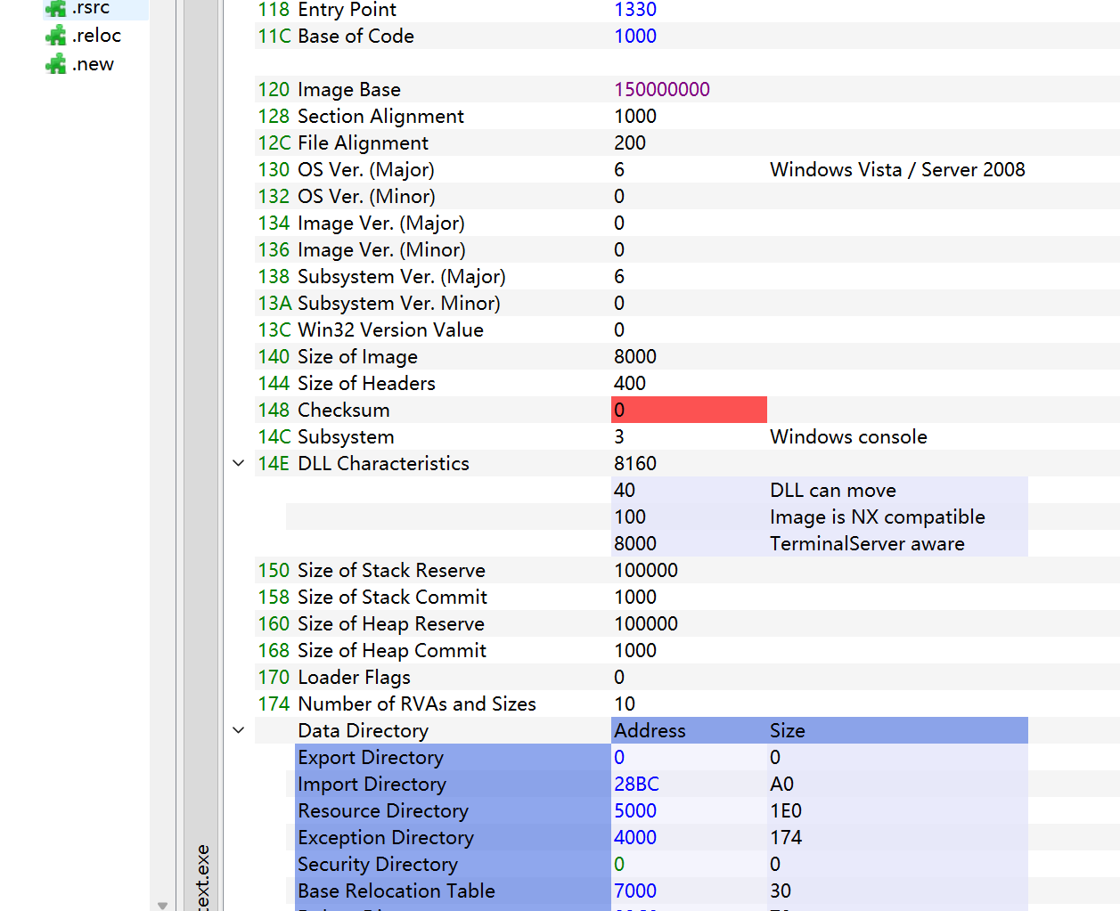
1 Challenges and Solutions
Challenges and solutions 1
I write a test and have some problem. In the test , I add a new section at the end of a executable , filling the new section by the data of ‘the Base Relocation Table’, Then I change the ‘ImageBase’ to ‘ImageBase + 0x1000’ and repair the relocation at the last section.
In the end, The ImageBase is 0x40001000, but the file can not execute. After I just change it to 0x50000000 , the file can execute. Why?
4

Slide 4
1 Plan
plan 1
Before 2023/9/20 finish the part of PE and C++.
I need to write the test in the video on my own.
4

